Slide 1

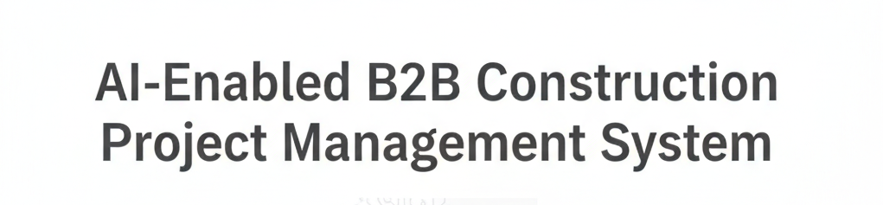
AI-Enabled B2B Construction & Architecture Project Management System
A. MAGHIMA LAKSHMI ,
R. REENA JENIFER ,
From B.TECH ( AI & DS).

Slide 2

ABSTRACT
This project presents an AI-Enabled B2B Construction Project Management System designed to support civil engineers and architects in managing projects and handling client interactions efficiently within an organization. Traditional construction management systems primarily focus on data storage and task tracking, lacking intelligent assistance for requirement analysis and decision support. To address this limitation, the proposed system integrates Artificial Intelligence as a virtual assistant that aids professionals in understanding client requirements, organizing project workflows, assisting in cost and material planning, and improving overall project coordination. it leverages a Large Language Model (LLM) to provide contextual guidance and operational convenience. The proposed B2B platform enhances productivity, reduces manual effort, minimizes errors, and improves client satisfaction, making it suitable for modern construction enterprises seeking intelligent and scalable project management solutions.

Slide 3
SOFTWARE SPECIFICATIONS
The proposed AI-Enabled B2B Construction Project Management System is developed using modern web technologies and AI frameworks to ensure scalability, reliability, and ease of use for civil engineers and architects.
Frontend: React.js, Tailwind CSS
Backend: Django
Database: PostgreSQL
AI Engine: Large Language Model (LLM) for intelligent assistance
Workflow Automation: Celery for task orchestration and notifications
Authentication: Role-based access control (Admin, Engineer, Architect)
Deployment: Cloud-based or On-Premise environment
Operating System: Windows / Linux
Development Tools: VS Code, Git, Postman

Slide 4

EXISTING SYSTEM
Focuses mainly on project tracking and data storage
Client requirements are collected manually
Decision-making depends on engineer/architect experience
No AI-based assistance for requirement analysis
Communication is often unstructured and fragmented
High chances of errors and rework
Limited automation and scalability

Slide 5

Drawbacks of Current Approaches
Data Silos
Manual Estimation
Project, client, and document data are disconnected across teams.
Cost and schedule estimates rely on manual rules and spreadsheets.
Poor Site Visibility
Client Communication Gaps
Limited automated analysis of site photos, progress, and safety risks.
Nonstandardized handoffs and reactive customer updates.

Slide 6
Proposed Methodology
Build an AI-native PM system that integrates domain models, supervised ML, and on-chain-like immutable logs. Key modules interact via event-driven microservices; AI models are trained on anonymized industry datasets and in-house project data
2. Domain Models & ML
1. Data Ingestion & Normalization
Specialized models for cost estimation, schedule optimization, defect detection, and resource allocation.
Structured imports (BIM, CAD, contracts), photo ingestion, IoT telemetry normalization.
4. Continuous Learning
3. Decision Support
Feedback loops capture outcomes to retrain models—improve accuracy over time.
Prescriptive recommendations, scenario simulation, and “what-if” planning.

Slide 7





Advantages of Proposed System
Faster Scheduling
Automated schedule generation and conflict resolution reduce planning time.
Accurate Estimates
AI-assisted cost models lower budget variance and surface hidden costs.
Improved Compliance
Audit trails and standardized templates reduce regulatory risk.
Better Client Experience
Centralized communications, milestones, and transparent change logs.

Slide 8
Literature Review
Condensed summaries of foundational papers and industry studies relevant to AI in construction project management.
1. ML for Construction Cost Estimation
Comparative study on regression and ensemble methods for accurate cost modeling.
2. Computer Vision for Site Monitoring
Image-based progress tracking and safety-detection using CNNs.
3. Schedule Optimization via Reinforcement Learning
Approaches to resource leveling and delay mitigation using RL agents.
4. Knowledge Graphs in AEC (Architecture, Engineering, Construction)
Semantic modeling of projects, assets, and regulation mappings.
5. Human-AI Collaboration in Project Management
Design patterns for explainability and actionable recommendations.
6. Data Governance & Privacy for Construction Data
Best practices for anonymization and compliance in industry datasets.
7. Case Study: Digital Twins for Construction
Benefits of real-time twin models for monitoring and decision support.

Slide 9
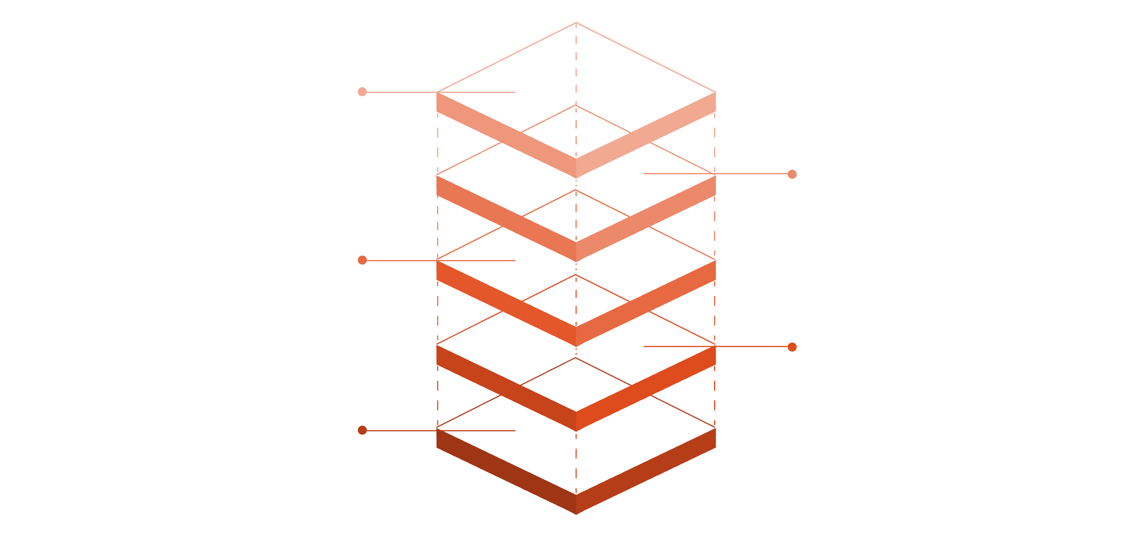
System Architecture Diagram
Frontend & Audit
Client UI and immutable logs
API Gateway
Secure role-based client access
Data Lake
Store normalized project data
AI Services
Estimation, CV, and scheduling models
Ingestion
Capture and normalize incoming events

Slide 10

Module Descriptions
Project Dashboard
Scheduling & Resource Planner
Cost & Contract Manager
Real-time KPIs, progress, and alerts with customizable views for engineers and architects.
AI-assisted schedules, clash detection, and crew allocation suggestions.
Estimate modeling, change-order tracking, and supplier invoicing workflows.
Document & BIM Hub
Client Portal & CRM
Site Intelligence
Customer-facing milestones, approvals, and communication history.
Image analysis, defect detection, and IoT integration for safety and progress tracking.
Central repository for drawings, versions, and linked metadata.

Slide 11

Project Scope, Next Steps & Deliverables
1
Scope
Deliver a production-ready SaaS platform tailored to B2B construction teams—AI modules, core PM features, secure client access.
2
Immediate Next Steps
Data inventory & ingestion pipeline, prototype AI models (estimation, CV), design MVP UI for engineers and architects.
3
Milestones & Deliverables
Prototype (8 weeks), Pilot with 1–2 firms (16 weeks), Production rollout (quarterly phased releases) and documentation.
4
Documentation Request
Full project documentation (software spec, architecture, literature references, module-level details) will be compiled into a development-ready doc set.

